Slide 1
Chairing Virtual Meetings
Malcolm Nudd – Director of Pathology Transformation
Amanda Price – Workforce Project Director
28.9.22

Slide 2
Aim and Objectives
Kent and Medway Pathology Network
Aim
To share experiences as chairs and meeting attendees in order to develop a network guide to chairing virtual meetings.
Objectives
To identify what makes a great experience as a virtual meeting attendee.
To hear from those on the call who have chaired virtual meetings on their experiences and what they have learnt.
To reflect on the differences, pros and cons between chairing real life and virtual meetings.
To develop a network guide to chairing virtual meetings.

Slide 3
When it all goes wrong!
Kent and Medway Pathology Network
Zoom Doom - The reality of bad virtual meetings - YouTube
How to Have a Bad Virtual Meeting - YouTube
Every Meeting You've Ever Been To (In Two Minutes) | Fast Company - YouTube
This Photo by Unknown Author is licensed under CC BY-NC

Slide 4
Kent and Medway Pathology Network
What makes a great experience as a meeting attendee?
This Photo by Unknown Author is licensed under CC BY-ND

Slide 5
Chairs reflections
Kent and Medway Pathology Network
What have you learnt during the last two years of chairing meetings online?
This Photo by Unknown Author is licensed under CC BY-ND
This Photo by Unknown Author is licensed under CC BY
This Photo by Unknown Author is licensed under CC BY-NC

Slide 6
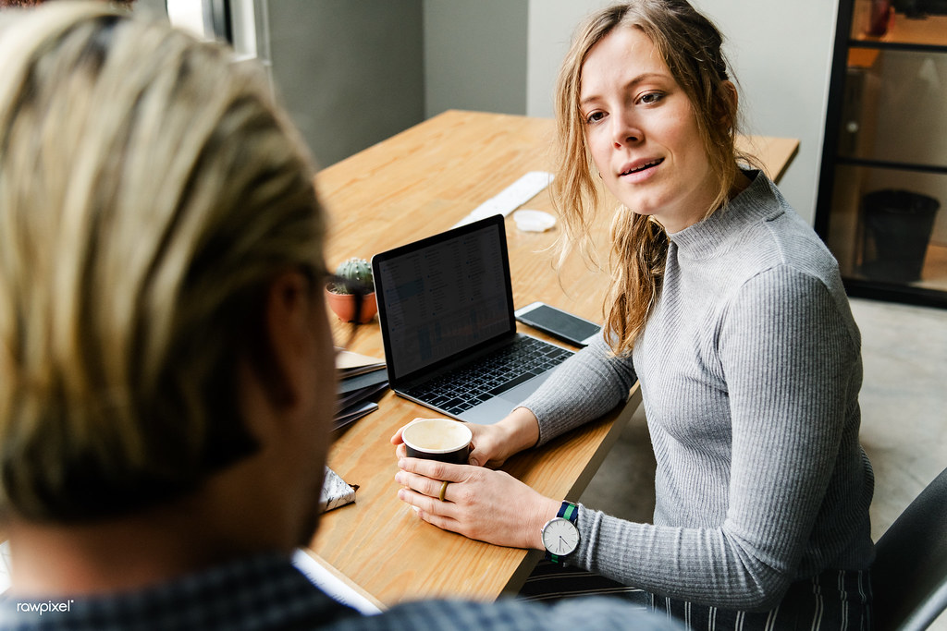
Organising and chairing meetings
Kent and Medway Pathology Network
Organising and Chairing Virtual Meetings - OneLearning - YouTube
This Photo by Unknown Author is licensed under CC BY

Slide 7
Association of Chairs Top Tips
Kent and Medway Pathology Network
1) Preparation – design the agenda differently
Timing
Breaks
A note on arrivals
Papers
Prepare the participants in advance
Set some ground rules
Have a co-host
Connecting with each other
2) Creativity
Presentations
Pen and paper
Non-verbal feedback
Consider the gathering time
3) Attentiveness
4) Have courage!
Consider using voting tools
Ask for feedback

Slide 8
King’s Fund Top Tips
Kent and Medway Pathology Network
The technical things for large meetings (more than 10–15 people)
Make sure everyone has the link for the meeting in good time.
Give people clear instructions about joining. Here’s an example.
Please join the meeting 3–5 mins before it starts so that you can check out your connection.
If you join late, join quietly and do not interrupt the conversation or the presentation. The facilitator will notice you’ve joined and welcome you at an appropriate point.
Background noise and audio feedback can disrupt the meeting. Please turn off your phone or anything else that might distract you or the other participants. When you are not speaking mute your mic.
Make any presentations short and digestible. People only listen for about 5–10 minutes. Keep slides very simple.
Build in a process for engaging people early on using questions. Some packages allow attendees to raise a hand, others offer a chat function. In a big meeting ask someone else – a chair or facilitator – to monitor the questions. It is distracting for the speaker to try to keep track of these.
If you are using a platform with break-out rooms, use them. People can connect in smaller groups, talking freely without using the mute button, or write on their own white board. All this helps people stay connected.
A large group meeting typically lasts no more than an hour.

Slide 9
King’s Fund Top Tips
Kent and Medway Pathology Network
The technical things for small meetings (typically 5–10 people)
For smaller meetings, many of the same guidelines apply when joining a meeting, but smaller meetings give an opportunity to create more trust and intimacy.
Don’t use the mute button. Encourage people to speak spontaneously. A small group can quickly learn to recognise each other’s voices if they regularly work together virtually. It is okay if people talk over each other and participants soon get used to it.
Try to avoid having some virtual and some face-to-face participants. So, don’t have part of the group gathered around a speaker phone in one room and others dialling in individually. This can create an ‘inner group’ with eye contact and side jokes, which does not help overall engagement or build trust across the group.
Small meetings are more interactive and may last longer. If they are longer than 1.5 hours do build in short breaks – listening and watching a screen are tiring.

Slide 10
King’s Fund Top Tips
Kent and Medway Pathology Network
The human things
A virtual space is exposing – like being in a goldfish bowl. People listen more intensively; think about how you say things – your tone and gestures.
Emotions get amplified too. You can be surprised by peoples’ responses which can seem stronger than you might expect; allow for this, check out what they mean and don’t overreact in response.
Relearn the basics of actively listening.
Don’t be afraid of silence. People are probably just thinking.
Remember the virtual nod. If people can’t see you, you need to say something or make a noise to acknowledge a comment or so people know you’re there.
Incorporate the informal. Don’t be totally task or agenda led. Allow time for people to share news, chat about parts of the meeting that spark interest, etc. You can’t have a virtual coffee, but you can have coffee virtually!

Slide 11
KMPN guide to chairing meetings virtually
Kent and Medway Pathology Network
Headings
Top tips

Slide 12
Kent and Medway Pathology Network
This Photo by Unknown Author is licensed under CC BY-NC

